Slide 1
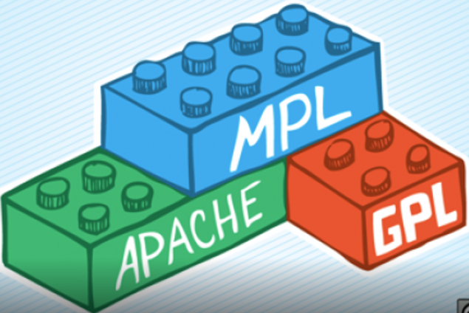



06 – Software Licensing and FOSS
COMP 190 – Dickinson College
Fall 2021
Images from: https://opensource.org/, https://www.fsf.org/
https://fossbytes.com/open-sources-license-type/

Slide 2
Intellectual Property Protections
Software, like other inventions and creative works, is the Intellectual Property (IP) of those that created it, or the companies they work for (i.e. work for hire).
Four main categories of legal protection for Intellectual Property
Trademarks
Patents
Copyrights
Design Rights
Notes:
If you create IP then you have the legal right to control how it is used.
Or if you create IP for an employer they will typically, due to your employment contract, have that right.
- This is known as a work for hire.
There are four main categories of legal protection that can be used to control how IP is used.
- Which one applies depends upon what you are protecting.
- We’ll deal with that in a moment.
- These are legal protections and thus are governed by national and international laws
- Extremely complex
- Will differ by country
- We’ll be trying to understand the basic ideas, see how they apply and look at some limited details.
- Legal teams deal with the details when it really matters.
We’ll be looking primarily at the first 3 now.
You’ll see a little bit about the 4th in the Activities.

Slide 3
Intellectual Property Protections
Discuss the following terms in small groups…
Trademarks
Patents
Copyrights
What is an example of something your group believes would be protected by each?
Give a general description of what each protects.
Notes:
You are likely familiar with these terms.
As a baseline… talk in small groups about each.
- Give 3-5 minutes.
No research… just based on what you know from common knowledge.
Report out and allow some responses.
- But not the goal to define the terms precisely here.
- That’s next.

Slide 4
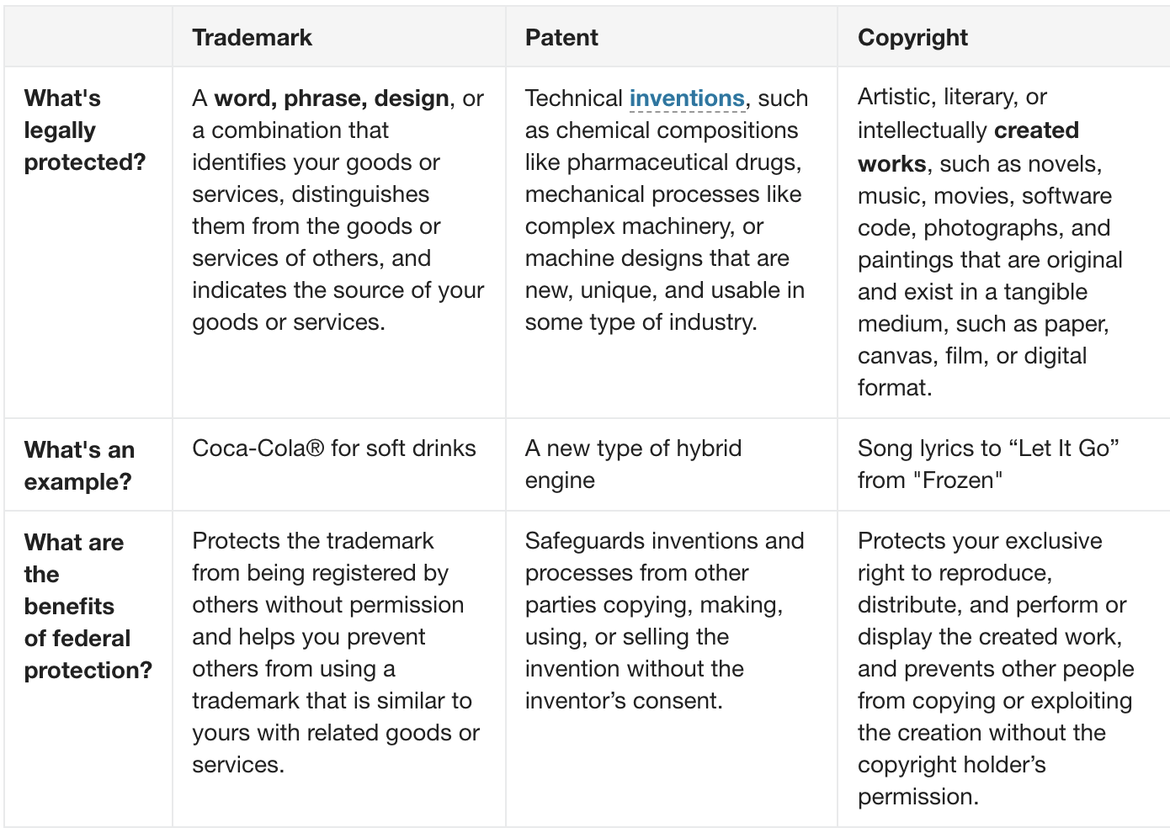
Activity
Using the table at:
https://www.uspto.gov/trademarks/basics/trademark-patent-copyright
Discuss and come to a consensus of the type of protection that is most likely to apply to the following:
This activity
The name Microsoft
The Java String class
The sound an iMac makes at startup
The linux kernel
Google’s PageRank algorithm
The term PageRank
Google’s implementation of PageRank
Notes:
Using the table which gives more precise – but still non-legal – descriptions
In your small groups
- Discuss the items listed
- come to a consensus on the type of IP protection that would likely apply to each.
- Likely take 10 minutes
Report out.
- discuss any disagreements among the groups.
- the last one is tricky…
- It’s both patent and copyright
- It is an expression of the patented process.
- It is exists in a tangible medium.
Notes:
- The word is a trademark of Google, and the PageRank process has been patented (U.S. Patent 6,285,999).
- Wikipedia
- The original PageRank patent, developed and owned by Google, expired on January 9th, 2019.
- Google holds an updated PageRank patent titled “Producing a ranking for pages using distances in a web-linked graph.”
- https://blogs.cornell.edu/info2040/2019/10/28/googles-pagerank-patent-has-just-expired-heres-what-happens-now/
- The iconic startup sound of Apple's Mac computers is now trademarked in the United States
- https://www.cnet.com/news/apple-wins-u-s-trademark-for-mac-boot-chime/

Slide 5
Software as Intellectual Property
For software as intellectual property it is possible that multiple protections apply:
It is a creative work that exists “in a tangible medium.”
That program is copyrighted
It can express a process that is “new, unique, and usable in some type of industry.”
That process is patentable.
It provides “goods or services” and the name “distinguishes them from others.”
That name is trademarked.
Notes:
This is a concrete recap of some of what should have come from discussion on prior slide.
- So may be quick.
All software, like every creative work, is immediately and automatically copyrighted.
- Including the shell script you wrote last week.
Software that expresses a novel process with commercial value is patentable.
https://arapackelaw.com/patents/softwaremobile-apps/recent-software-patent-examples/
- Googles pageRank algorithm for ranking search results
- AirBnB – automated determination of booking availbility
- CoinBase – instant exchange of bitcoin payments
- Facebook – dynamic mask application
Software provides services and thus can be given a name and trademarked to brand them.
- Microsoft Word, Windows, PowerPoint, etc
- Adobe Acrobat
- Safari,

Slide 6
Software and Licensing
Software licenses are legal documents that use copyright to grant or restrict the way that software may be used, copied, modified and distributed.
Proprietary Software Licenses
Commercial development
Restrictive
Free and Open Source Software (FOSS) Licenses
Community development
Permissive
Notes:
Two broad categories of licenses.
Proprietary licenses
- Usually employed by companies who earn money from the sale of the software
- These licenses are typically restrictive and use the copyright ownership to:
- keep the code secret
- prohibiting copying, sharing or modifying the software
- protect the company’s ability to make a profit from the sale of the software.
FOSS licenses
- Employed to ensure the software is available to benefit everyone.
- The value here is not commercial.
- Instead the value is:
- its availability for all to use and improve
- the expanded community working on its development
- the expanded community of users
- These licenses are generally permissive and use the copyright ownership to:
- Grant others the rights to “the 4 freedoms”
- Free to run and use it for any purpose
- Free to redistribute it
- Free to study and modify it
- Free to redistribute it with modifications

Slide 7
FOSS Licenses
A license makes software Free and Open Source by granting specific permissions on how others may use the copyrighted work and by specifying what is required in order to receive those permissions.
Permissive Licenses
“Do Anything” / “Anything Goes”
Copyleft Licenses
“Share-a-like” / “Viral”
Notes:
Two extremes of FOSS licenses
- There is now a spectrum of licenses n between these two extremes
- Permissive
- Grant the user the right to do pretty much anything they want with the IP.
- With minimum if any requirements of the user.
- Also called “do anything” or “anything goes” licenses.
- Copyleft (a play on copyright)
- Usually grant the 4 freedoms.
- Require that in order to receive those permissions what you produce must also have a copyleft license.
- Also called “share-a-like” or “viral” licenses
- Share-a-like if you want a positive connotation
- Viral if you want a negative connotation

Slide 8
The MIT License (MIT)
Copyright (c) <year> <copyright holders>
Permission is hereby granted, free of charge, to any person obtaining a copy of this software and associated documentation files (the "Software"), to deal in the Software without restriction, including without limitation the rights to use, copy, modify, merge, publish, distribute, sublicense, and/or sell copies of the Software, and to permit persons to whom the Software is furnished to do so, subject to the following conditions:
The above copyright notice and this permission notice shall be included in all copies or substantial portions of the Software.
THE SOFTWARE IS PROVIDED "AS IS", WITHOUT WARRANTY OF ANY KIND, EXPRESS OR IMPLIED, INCLUDING BUT NOT LIMITED TO THE WARRANTIES OF MERCHANTABILITY, FITNESS FOR A PARTICULAR PURPOSE AND NONINFRINGEMENT. IN NO EVENT SHALL THE AUTHORS OR COPYRIGHT HOLDERS BE LIABLE FOR ANY CLAIM, DAMAGES OR OTHER LIABILITY, WHETHER IN AN ACTION OF CONTRACT, TORT OR OTHERWISE, ARISING FROM, OUT OF OR IN CONNECTION WITH THE SOFTWARE OR THE USE OR OTHER DEALINGS IN THE SOFTWARE.
Notes:
Let’s look at an example of a license.
- Note: The small text is less relevant to this conversation…
- Is this license permissive or copyleft?
- Why do you think that?
What permissions does this license grant?
- can cell it, can relicense it
Anything surprising there?
- You can sub-licence and/or sell copies!
- You could use it in a commercial product
- Important Note:
- This license allows but does not require that you permit persons to whom you furnish the software do the same.
- You can place any restrictions you like on your version – i.e. sublicence it.
- But note that they can still do what they want with the original (i.e. get it from where you got it).
What does this license require for you to receive these permissions?
- Only that the copyright and permission notice be included.
- Note that the notice only applies to the pieces that you used that were under the original license.

Slide 9
GNU GENERAL PUBLIC LICENSE Version 3, 29 June 2007
Copyright (C) 2007 Free Software Foundation, Inc
…
5. Conveying Modified Source Versions. You may convey a work based on the Program, or the modifications to produce it from the Program, in the form of source code under the terms of section 4, provided that you also meet all of these conditions:
a) The work must carry prominent notices stating that you modified it, and giving a relevant date.
b) The work must carry prominent notices stating that it is released under this License and any conditions added under section 7. This requirement modifies the requirement in section 4 to “keep intact all notices”.
c) You must license the entire work, as a whole, under this License to anyone who comes into possession of a copy.
…
Notes:
Let’s look at another example of a license.
- Note: This is just a small part of this particular license.
- Is this license permissive or copyleft?
- Why do you think that?
What permissions does this section grant?
- what does it mean to convey?

Slide 10
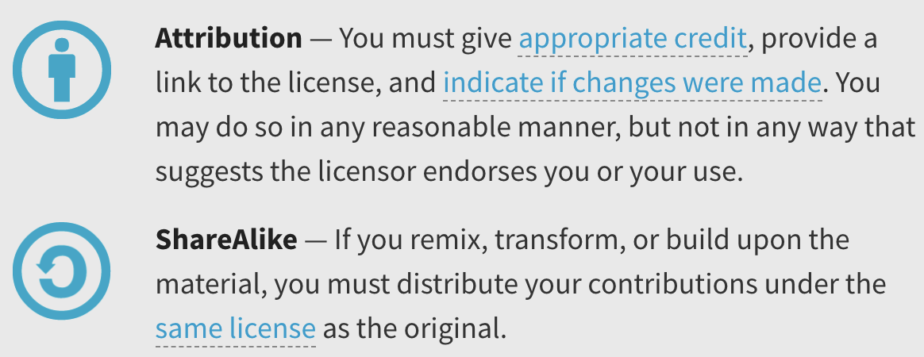
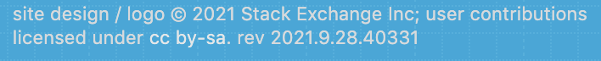

This Can Get Complicated…
Consider code snippets posted to Stack Overflow…
https://meta.stackexchange.com/questions/12527/do-i-have-to-worry-about-copyright-issues-for-code-posted-on-stack-overflow
Notes:
CC indicates a Creative Commons License
A CC license like others grants permissions for the use of copyrighted material
With requirements. Here:
- by means you must provide attribution if you use it.
- sa means you must share alike
What implications or questions does that raise?
- Some possibilities:
Commercial software houses go to great length to ensure that no copyleft code appears in their products.

Slide 11
What’s Next?
A06/Q06 – 1 Week
Revise and resubmits
Prepare for the reading and discussion

Slide 12

Acknowledgments:
Slide Template From:
https://creativecommons.org/licenses/by/4.0/
Slide Content Licensed as:
https://creativecommons.org/licenses/by-nc/4.0/
Notes:
Might be a good time to point out this!
And the CC on the first slide too.

